Slide 1

2019 Massachusetts Board of Higher Education Trustees Conference
Comprehensive
Presidential Evaluations
March 28, 2019
Westborough, MA

Slide 2
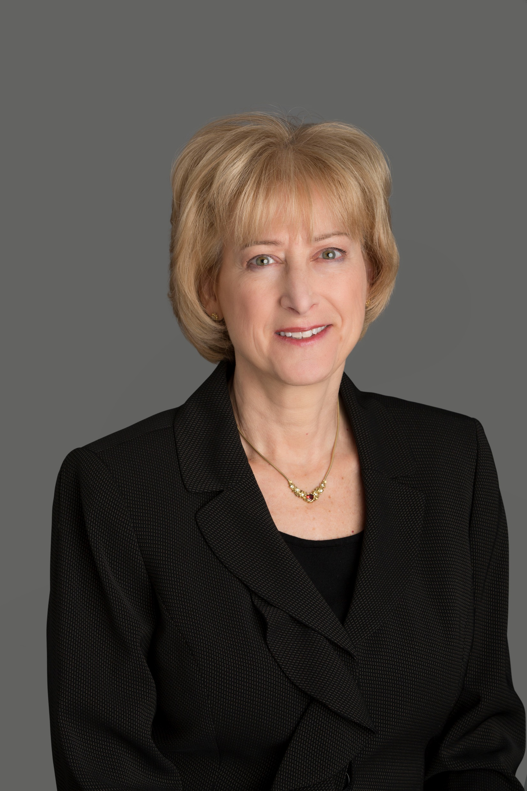
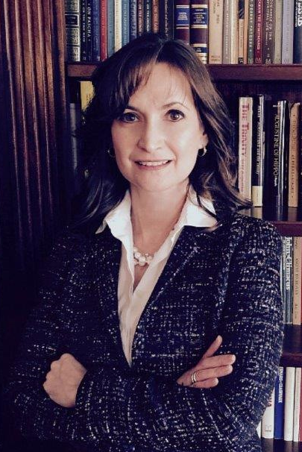
Presenters
Merrill P. Schwartz
Senior Vice President, AGB
BA, UMass, ‘78
MPA, UMass, ‘81
PhD, U MD, ‘98
Dena Papanikolaou,
General Counsel, Massachusetts Department of Higher Education
BA, Brandeis University
JD, Suffolk U Law

Slide 3
Agenda
Why Presidential Assessment Matters
Boards and Presidents
The Massachusetts Context
Annual Assessment
Periodic Comprehensive Evaluations
Discussion and Q & A

Slide 4
Why Presidential Assessment Matters
Good practice—set goals and assess progress, enhance performance, improve board/president relationship
State law—requires assessment annually and comprehensively every 3 or 5 years; informs compensation
Institutional accreditation—NEASC standard 3.10: The board appoints and periodically reviews the performance of the chief executive officer...

Slide 5
Boards and Presidents
Select, support, and assess
Trustees as fiduciaries—act collectively, independent of appointing authority (no Lone Rangers)
Board chair/president relationship key—but chair and board must act together
Regular communication, not once a year
Accountability: transparency; communication; shared vision, goals, and priorities

Slide 6
The Academic Presidency
“The president acts within an institutional context which is determined by the attitude of the faculty, the behavior of the student body, the presence or absence of collective bargaining, the influence of alumni, legislators and self-interest groups, the degree of control by the central office in a statewide system, and most critically the extent of authority and responsibility of the governing board. An adequate appraisal of the president’s role must take into account the attitudes, prerogatives and behavior of these groups.”
John Nason

Slide 7
Challenges Assessing Leadership in the Academic Presidency
Metrics of performance: no single bottom line, operational and strategic indicators, qualitative and quantitative data, many constituencies, competing goals
Like steering a battleship
Complex role of governing board, supporting and evaluating the president
Trustees at a distance, from diverse fields; board conflicts and back channels
Social media, 24/7 job

Slide 8
The Massachusetts Context
Open meeting laws: 7 exceptions—presidential assessment is not one
Institutional and system/state goals
Institutional board and MBHE roles
Fiscal realities for compensation

Slide 9
Annual Assessment Process
Assessment Committee Review
President’s self-assessment
feedback from other board members
feedback from other sources
questionnaires and surveys: not typical
Review with President
board chair and chair of the committee meet promptly with the president to provide feedback
documented oral and/or written review focusing on the future
http://www.mass.edu/foradmin/trustees/documents/AnnualPresidentialEvaluationOutline.pdf

Slide 10
Periodic Comprehensive Evaluations:
Multi-Source or 360 Reviews
Purposes
systematic feedback
leadership development
reflect on the evolution of a presidency
Periodic
every 3 to 5 years
comprehensive look at years under review
avoid crises and public controversies

Slide 11
Periodic Comprehensive Evaluations:
Protocols and Participants
Protocols for Multi-Source or 360 Reviews
board committee for presidential assessment including president
staff support
notify participants about the purposes of the review and their role
Typical participants
governing board, senior staff, representatives of faculty, students, staff, alumni, local leaders and officials

Slide 12
Comprehensive Evaluation Process
Board selects committee member(s); committee selects consultant
Board chair sends email to participants or the campus community explaining the purpose of the evaluation
President prepares self-assessment and supporting materials
Committee/consultant in consultation with board chair and president prepares list of interviewees
Committee and president establish criteria for review (goals and leadership characteristics)
Committee/consultant develops interview protocol and questionnaires

Slide 13
Comprehensive Evaluation Process (cont.)
Consultant conducts individual and group interviews on campus and some by phone
Consultant shares preliminary findings with president and committee chair/board chair
Consultant reports findings & recommendations to the president and committee chair/board chair who share with board including plan for leadership development and improved organizational effectiveness
Committee documents process, submits summary by deadline, sends follow-up communications
Process completed in about 3 months

Slide 14
Topics for Interviews on President’s Performance
Strategic Leadership
Academic Leadership
General Management
Financial Management
Fundraising
External Relations
Internal Relations
Governance
Leadership Style & Values (this is often a focus)
Other

Slide 15
Survey or No Survey?
Advantages
Expands participation
May cost less than and complement interviews
Quantifiable responses
Disadvantages
Review isn't a democratic process
Challenge to design a good instrument
Quantifiable responses

Slide 16
Potential Survey Items—open ended
What have been the president’s major accomplishments in leading the institution over the past three years?
What would you suggest to improve the president’s effectiveness?
Suggestions for goals for the president and the University for the next three years?

Slide 17
Leadership Development
Coaching and mentoring: conflict resolution and team building
Leadership seminars and peer discussions, some at national meetings
Re-organizing decision-making processes and positions
Personal renewal: writing and professional travel
Renewing board/president communication

Slide 18
Process Issues and Special Situations
Risk Management: political, financial, reputational and other risks; off-campus with media, governor, legislators, and alumni; and on campus with unions, faculty, staff, and students
Divisions within the board
Dealing with votes of no confidence
Other topics

Slide 19
Resources
Massachusetts Department of Higher Education
Dena Papanikolaou, CPapanikolaou@dhe.mass.edu
Online Trustee Resources
http://www.mass.edu/foradmin/trustees/home.asp
http://www.mass.edu/foradmin/trustees/preseval.asp
Compensation and Evaluation Guidelines and Procedures
Annual Presidential Evaluation Outline
AGB
Merrill Schwartz, mschwartz@agb.org
www.agb.org
Assessing Presidential Effectiveness

Slide 20
Questions and Discussion

Slide 21
MBHE Annual Presidential Evaluation: Outline of Report
Executive Summary
Process used
Review of institutional goals
Review of system-level goals
Recommendation for compensation adjustment
Attachments (goals, self-assessment, data, metrics, etc.)
http://www.mass.edu/foradmin/trustees/documents/AnnualPresidentialEvaluationOutline.pdf

